Slide 2
February 8, 2023

Slide 3
Member Update

Slide 4
Introductions

Slide 5
Minutes

Slide 6
Treasurer’s Report

Slide 7
C.E.R.T Update

Slide 8
C.E.R.T Radio Shirt

Slide 9
C.E.R.T Radio Shirt

Slide 10
Local Happenings

Slide 11
Euless ARC Gatherings
ERBC – Every Friday, @ 0830
Texan Kitchen 415 N Main, Euless, TX 76039
Club Social – Monday, Feb. 20th 1800 – 1900
Cotton Patch 4020 William D Tate Ave, Grapevine, TX 76051

Slide 12
Upcoming Events
February
Skywarn NWS: Dallas County
Saturday Feb. 18th 0900
Location: Granville Arts Center;
The Atrium, 300 N. 5th St.,
Garland, TX 75040
Skywarn: NWS - Virtual
Tuesday, February 21st @ 1900

Slide 13
Upcoming Events
February
(Continued)
Cowtown Marathon: February 24-26
Skywarn NWS: Denton County
Saturday February 25th 1000
Location: Texas Women's University,
MCL Auditorium
1200-1242 N Bell Ave, Denton, TX 76209

Slide 14
Upcoming Events
March
Greater Houston Hamfest,
March 3rd 1400 & 4th 0800
Skywarn school: NWS - Virtual
Saturday, March 4th @ 0930
Irving Hamfest, Mar. 5th, 0800 – 1400,
2400 W. Irving Blvd.

Slide 15
Upcoming Events
March
(Continued)
Skywarn school: NWS - Virtual
Tuesday, Mar. 21st @ 1900
Fort Worth: R.A.C.E.S. New members,
March 25, FW EOC,
Online QSO Today Virtual Ham Expo, March 25 - 26 www.qsotodayhamexpo.com

Slide 16
Upcoming Events
April
Fort Worth R.A.C.E.S. Renewal,
April 4th, FW EOC,
Texas State Parks on the Air to Commemorate
Tom King, WK5DX, the Texas Event's Founder
Event Timing: April 15-16, 2023
Event Address: Anywhere your radio is!
Contact us at k5lrk.tx@gmail.com
https://www.tspota.org/home

Slide 17
Upcoming Events
April
(Continued)
World Amateur Radio Day
Tuesday, April 18th 0000 - Wednesday, April 19th 0000
Arbor Daze, Saturday, April 29th, Midway Park

Slide 18
January Recap
Fox Hunt
Arbor Daze
Field Days
Audit
Scouting
Charities

Slide 19
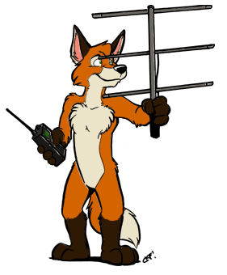
Fox Hunts:
March 11 2023
Committee:
Chris Shanahan
Volunteer #2
Volunteer #3

Slide 20
Arbor Daze
April 29, 2023
Committee:
George Smith
Volunteer #2
Volunteer #3

Slide 21
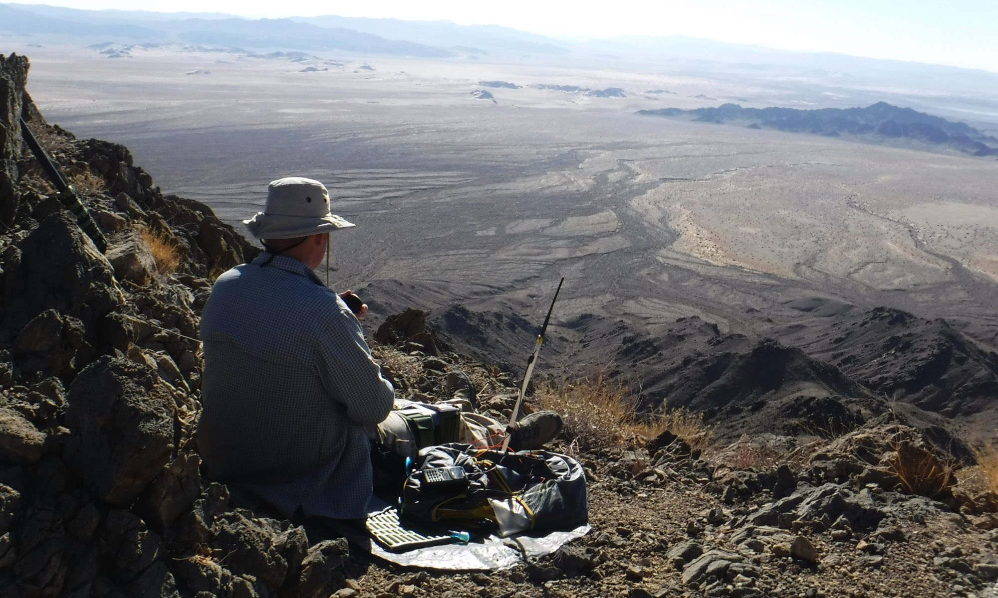
Committee:
Dewey Walker
Volunteer #2
Volunteer #3
Field Day
June 24-25

Slide 22
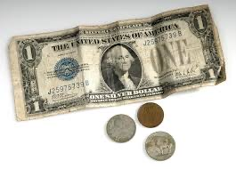
Audit Committee
Audit Committee:
George Smith
James Knighton
Greg Sieber

Slide 23
Tech Classes
October 21 2023
Committee:
Erik Bedoya
Greg Sieber
Chris Shanahan

Slide 24
Scouting
Committee:
Chris Shanahan
Volunteer #2
Volunteer #3

Slide 25
Charities
Charity Committee
Volunteer #1
Volunteer #2
Volunteer #3

Slide 26
Our interests include:
2 M //
70 CM //
CW //
Fox Hunting //
Public Emergencies Service Radio
QRP
SSB
Winlink
Working satellites
WSPR
What kind of club are we?
Our Members are also members of CERT, RACES and ARES.

Slide 27
What kind of club do
we want to be?
Fox hunts
Hands on instruction
Elmering
Build Projects
Learn how things work (ie. Antennas)

Slide 28
WSPR
Dewey Walker KI5UWK

Slide 29
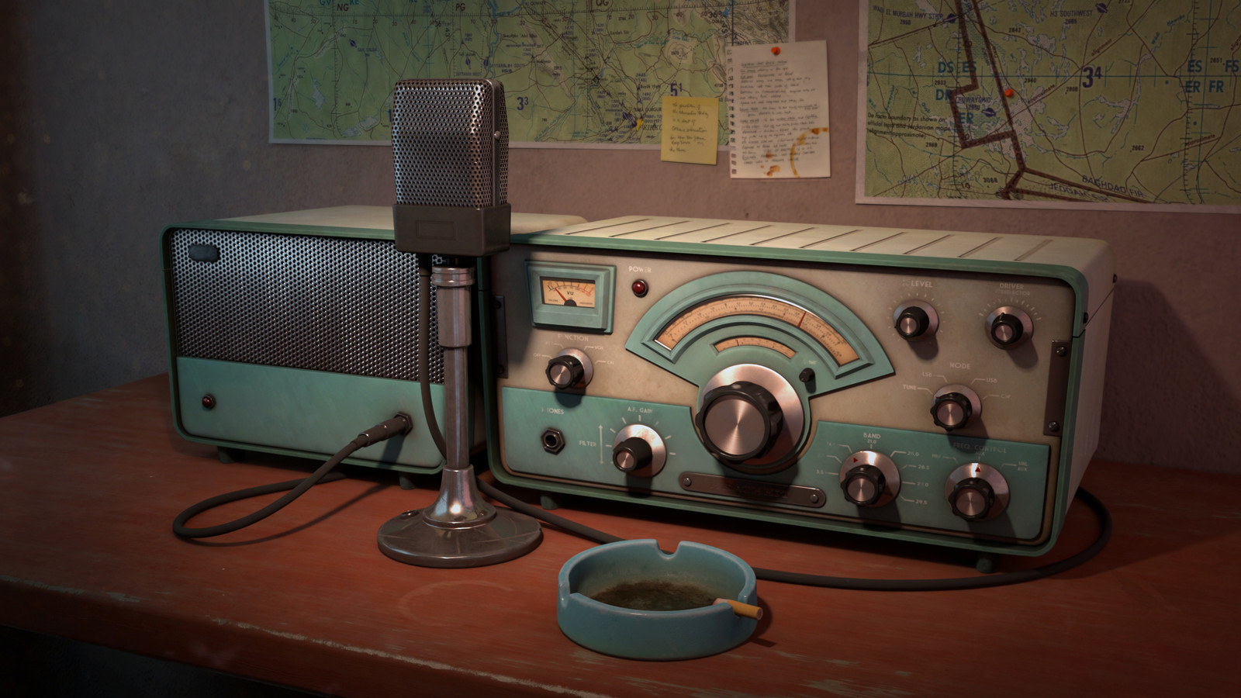
Erik
Greg
Chris
Members
Open Chat

Slide 30
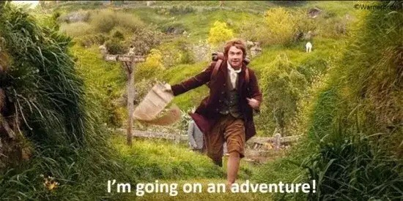
Motion To Adjourn

