Slide 2
May 10, 2023

Slide 3
Introductions

Slide 4
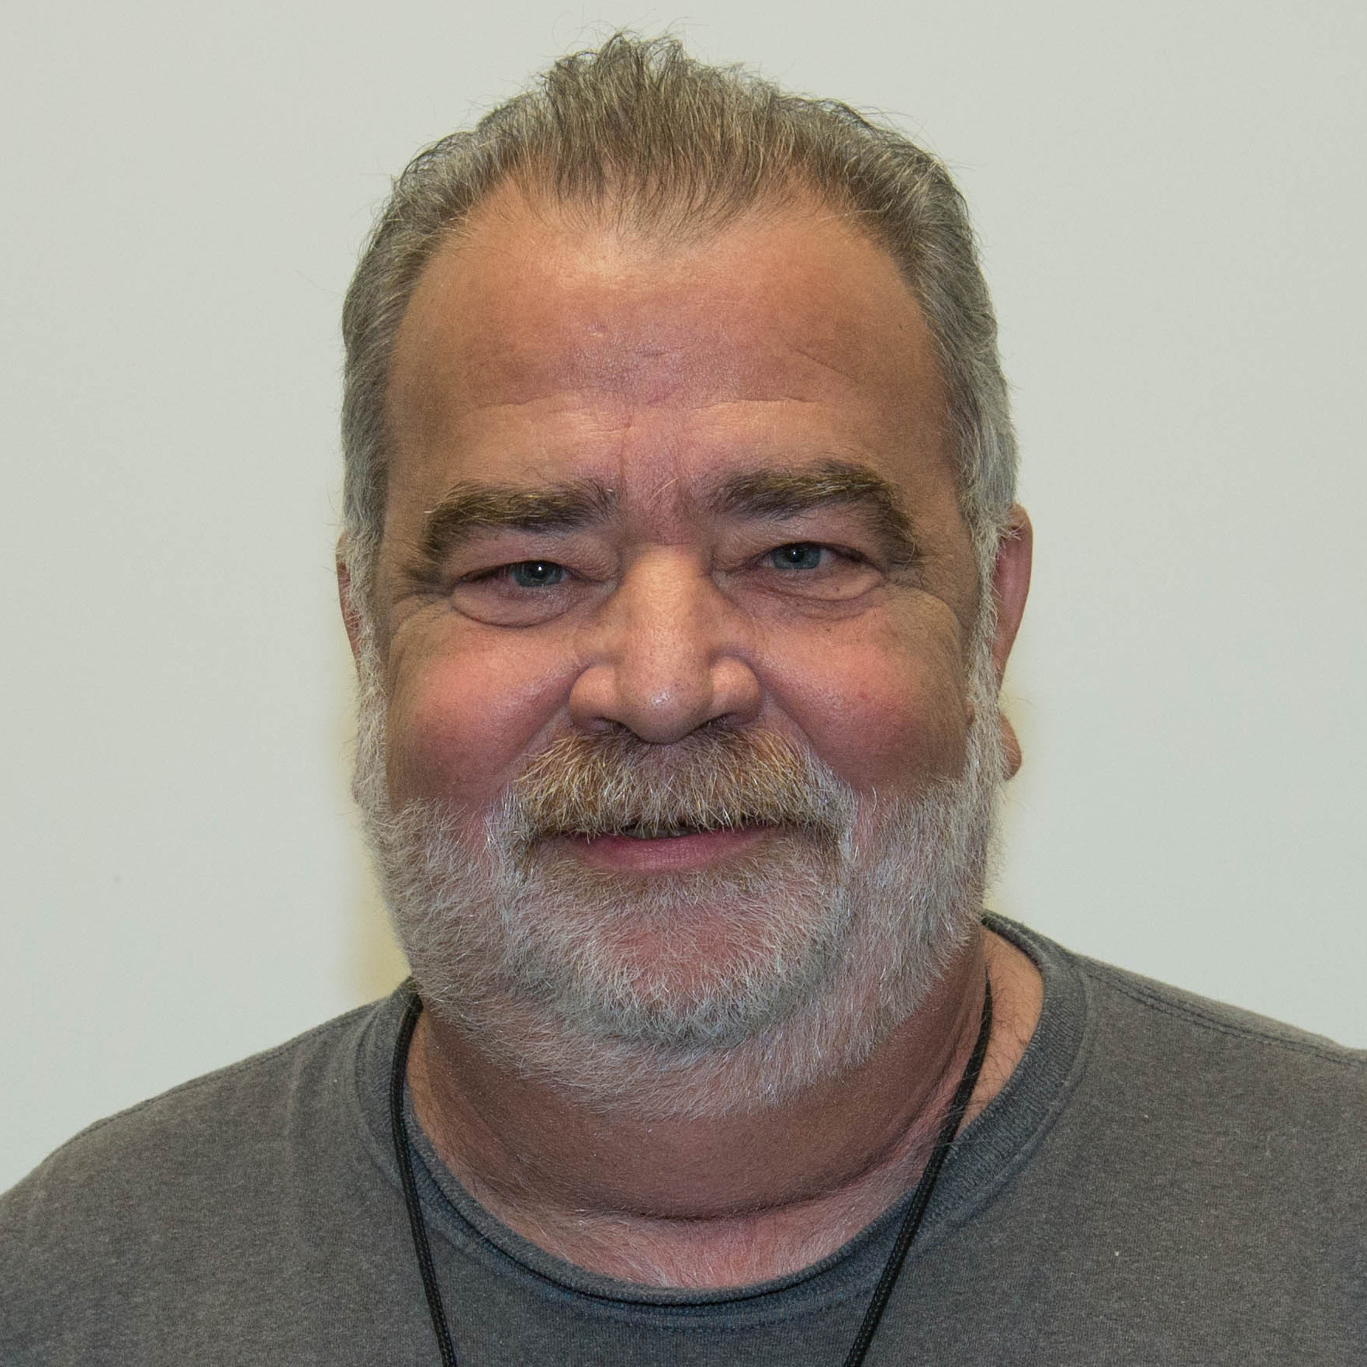
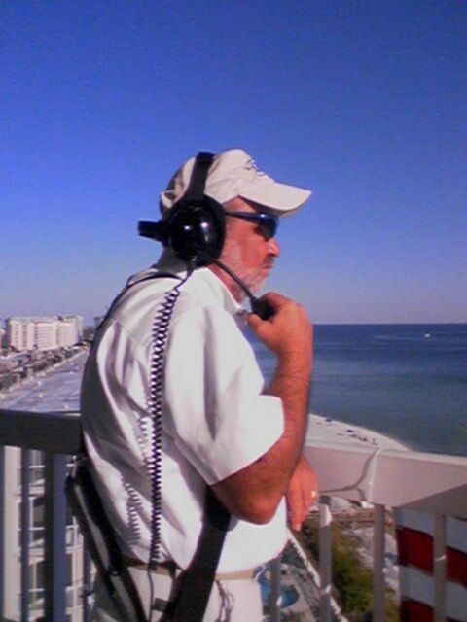
John Brunner KG5VTT

Slide 5
John Brunner
~ Celebration of Life ~
Thanks for the Memories
Sunday, June 25, 2023 2-5 pm
Please join us for an afternoon of remembering John with your favorite memory, story, or anecdote.
Italian Bistro
501 E. Byron Nelson Blvd, Roanoke, TX 76262
italian-bistro.net

Slide 6
Member Updates

Slide 7
Minutes

Slide 8
Treasurer’s Report

Slide 9
C.E.R.T Update

Slide 10
Local Happenings

Slide 11
Euless ARC Gatherings
ERBC – Every Friday, @ 0830
Texan Kitchen 415 N Main, Euless, TX 76039
Club Social – Monday, June 19th, 1800 – 1900 Outback 2601 State Highway 121 S, Euless, TX 76039
Field Day - June 24th, 1300 - 2000, Villages of Bear Creek Park, near the Dog Park on Bear Creek Pkwy, Euless, TX 76039

Slide 12
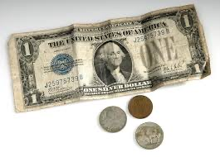
Audit Committee
Audit Committee:
George Smith
James Knighton
Greg Sieber

Slide 13
Upcoming Events
June
Field Day, June 24-25, Update courtesy of Dewey Walker

Slide 14
Upcoming Events
July
Independence Day, July 4,
IARU HF World Championship, July 8-9 https://www.iaru.org/reference/member-societies/

Slide 15
Upcoming Events
August
222 MHz and Up Distance Contest, August 5-6, http://www.arrl.org/222-mhz-and-up-distance-contest
EME 2.3 GHz and up, August 12-13, http://www.arrl.org/eme-contest
10 GHz and up - Round 1, August 19-20, http://www.arrl.org/10-ghz-up
Rookie Roundup - RTTY, August 20, http://www.arrl.org/rookie-roundup

Slide 16
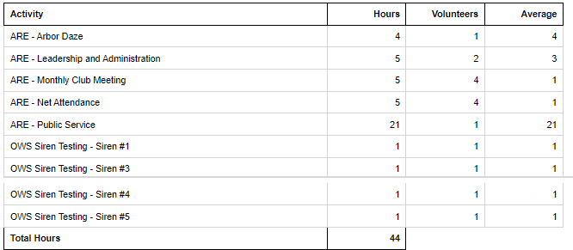
Volunteer Hours

Slide 17
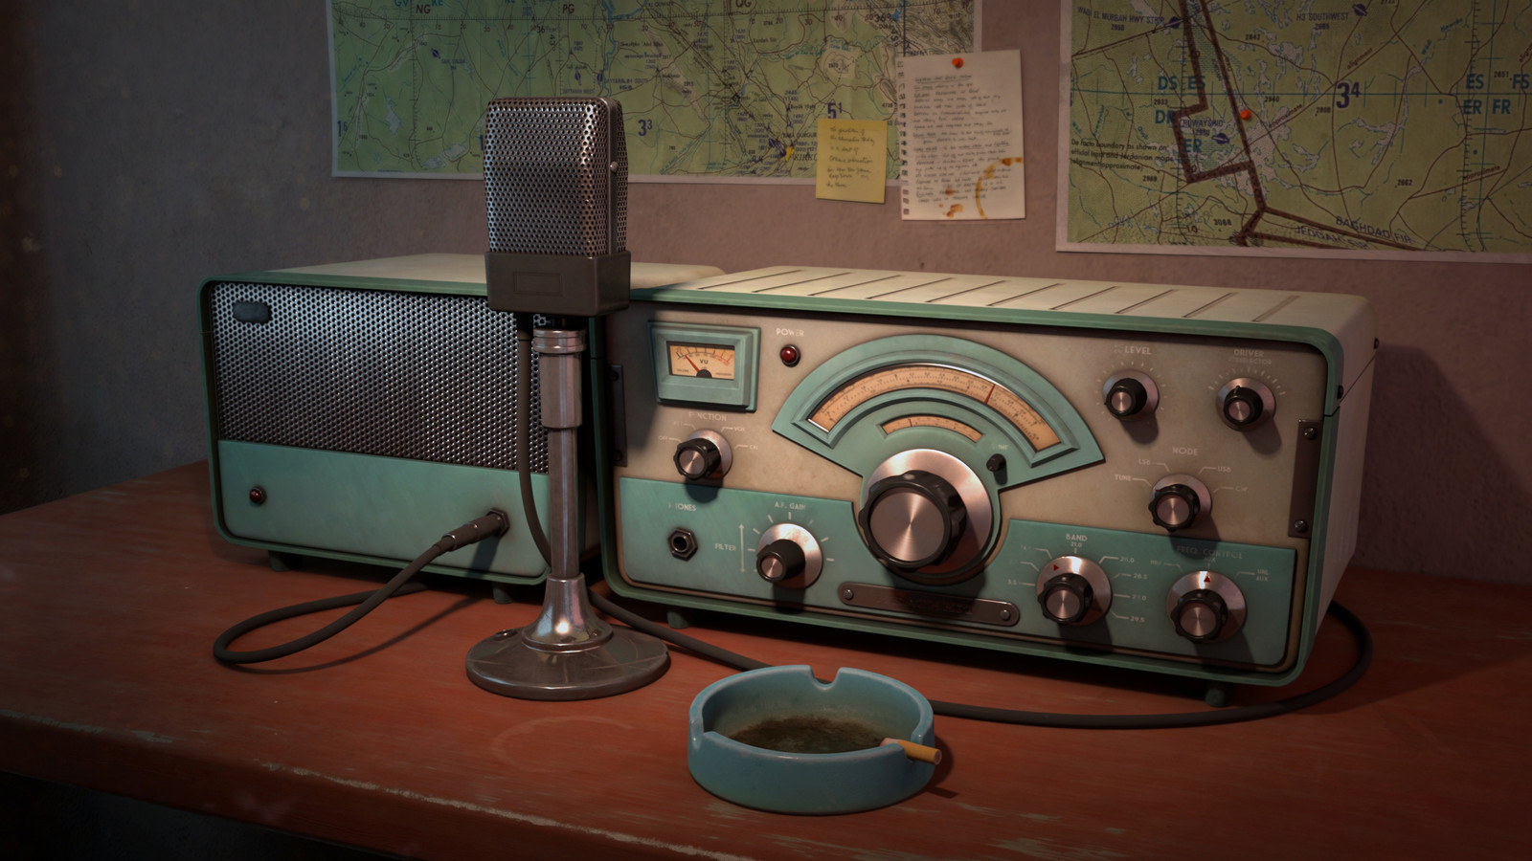
Erik
Greg
Chris
Members
Open Chat

Slide 18
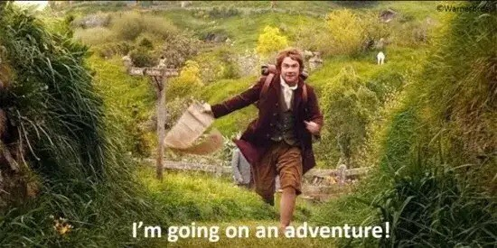
Motion To Adjourn

