Slide 2
May 10, 2023

Slide 3
Introductions

Slide 4
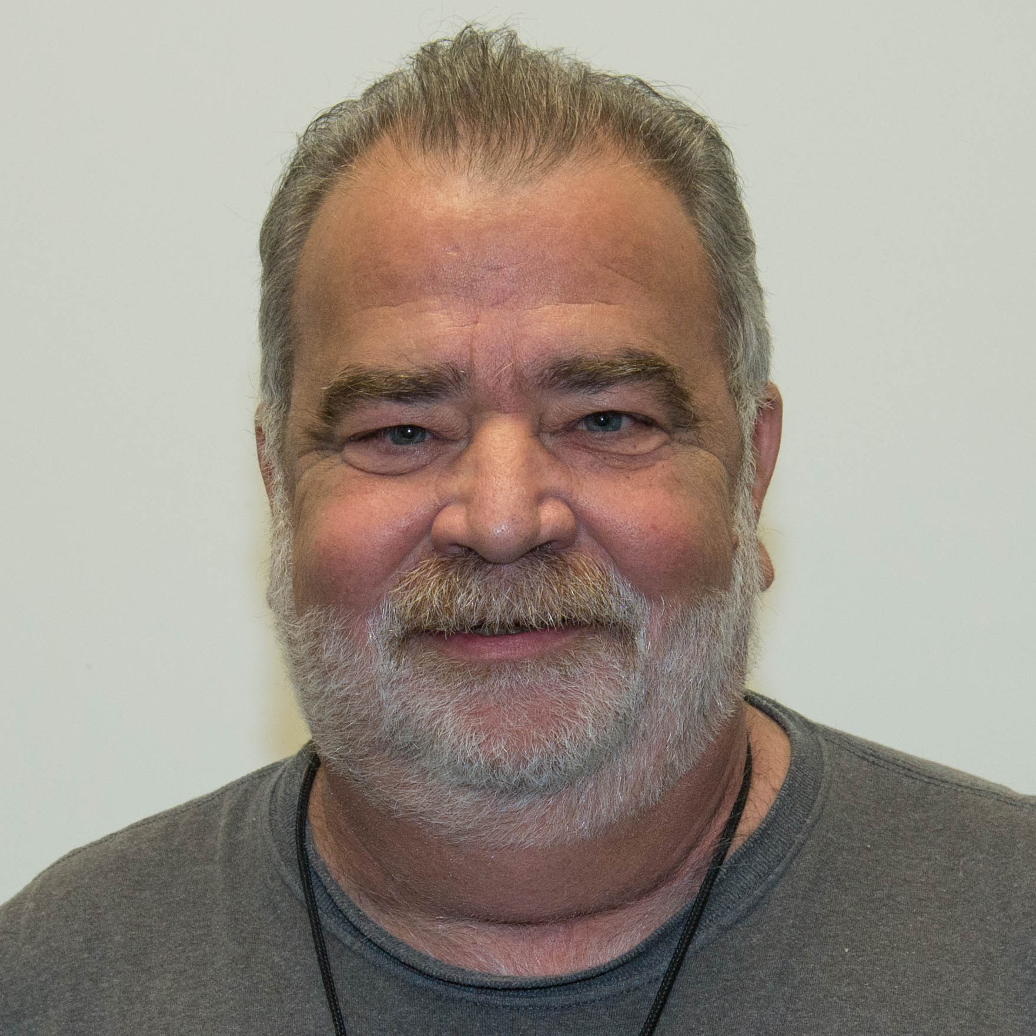
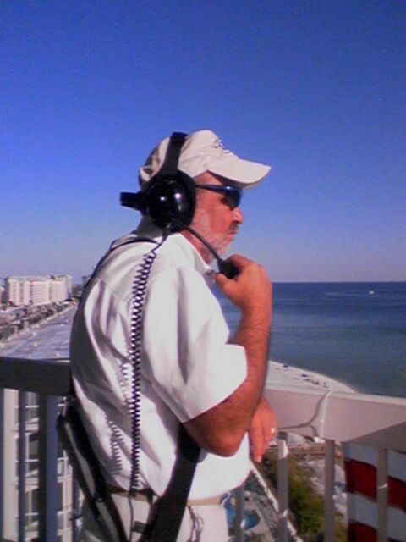
John Brunner KG5VTT

Slide 5
Member Updates

Slide 6
Minutes

Slide 7
Treasurer’s Report

Slide 8
C.E.R.T Update

Slide 9
Local Happenings

Slide 10
Euless ARC Gatherings
ERBC – Every Friday, @ 0830
Texan Kitchen 415 N Main, Euless, TX 76039
Ham after Eggs, 2nd & 4th Saturdays May 13 & 27,
0900-1100 Fuzzy’s Taco Shop Euless Blvd,
1100-0200 EPD Training Rm (TBD)
Club Social – Monday, May 15th, 1800 – 1900
Mod Pizza 2321State Highway121, Unit 100, Euless, TX 76039

Slide 11
Upcoming Events
May
Metrocrest Amateur Radio Society Radio Play Day, May 20, 10:00 - 15:00 Carrolton Josey Lake Ranch Library 1700 Keller Springs Road *3rd Saturday of each month

Slide 12
Upcoming Events
June
DFW Ham Expo, June 3, 0900-1500, Vista Mall, Lewisville
Field Day, June 24-25, Details to come…

Slide 13
Hamfests and Expos:
Roadtrips?

Slide 14
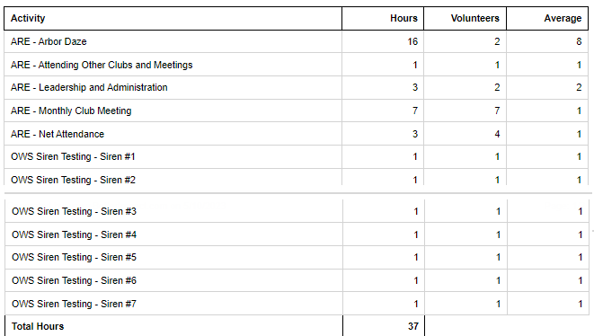
Volunteer Hours

Slide 15
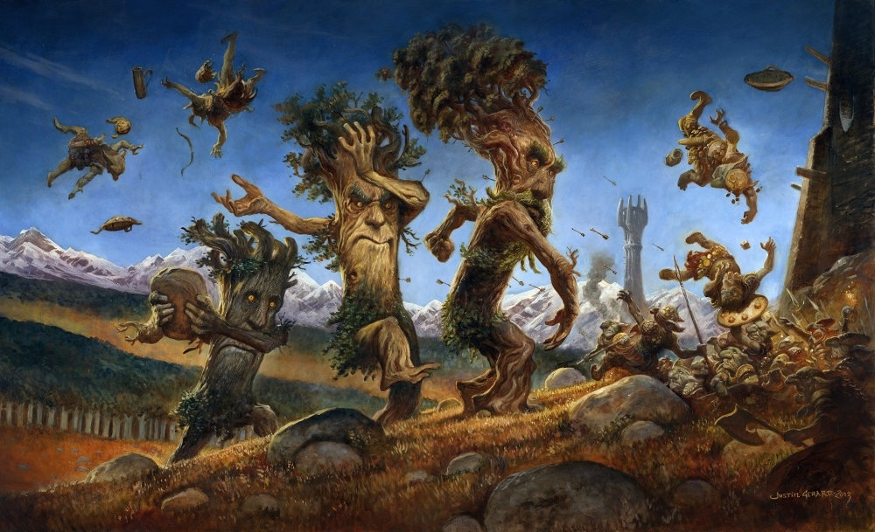
Arbor Days Recap

Slide 16
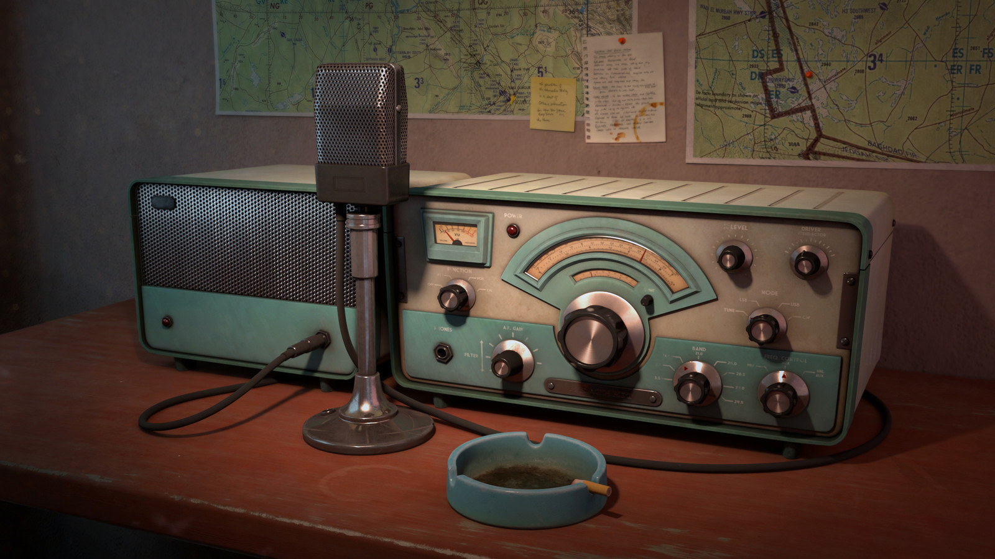
Erik
Greg
Chris
Members
Open Chat

Slide 17
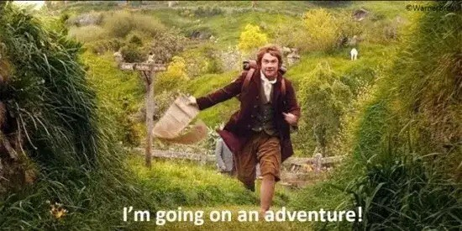
Motion To Adjourn

