Slide 2
August 14, 2024

Slide 3
Introductions

Slide 4
Member Updates

Slide 5
Minutes

Slide 6
Treasurer’s Report

Slide 7
C.E.R.T Update

Slide 8
Local Happenings

Slide 9
Euless ARC Gatherings
ERBC – Every Friday, @ 0830
Texan Kitchen 415 N Main, Euless, TX 76039
H‑E‑B Joint Radio Club Breakfast, every 3rd Saturday, Egg Haven Cafe, 760 Airport Fwy, Suite 100, Hurst, RSVP by midnight Thursday
Club Social – Monday, August 19, 1800 – 1900 Rosa’s Cafe 2711 SH-121 Euless, TX 76021

Slide 10
Upcoming Events
August
CERT Team Training: Location TBD, Saturday, August 17, 1900
NE Tarrant Joint Team Meeting: Hurst EOC, Fire Station #2, Saturday, August 17 0900-1100, Talk-in will be on the Hurst 2m repeater, 147.100+110.9.

Slide 11
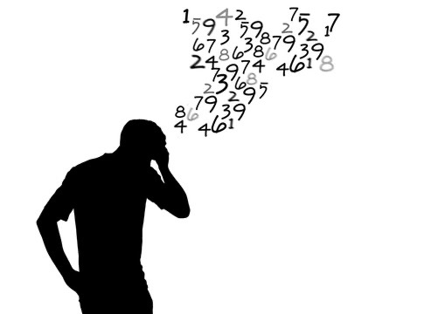
Please log your hours.

Slide 12
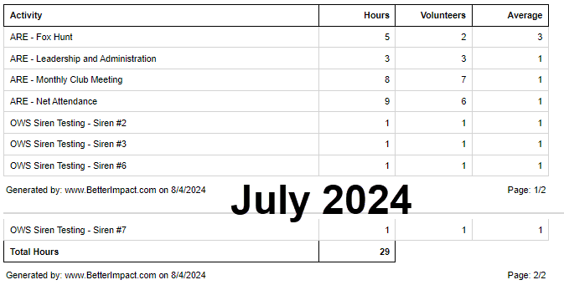
Previous Month Hours

Slide 13
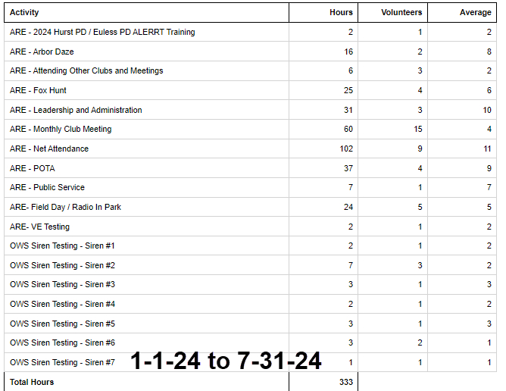
Year To Date Hours

Slide 14
Planning
Sunday 8/25 or Saturday 8/31

Slide 15
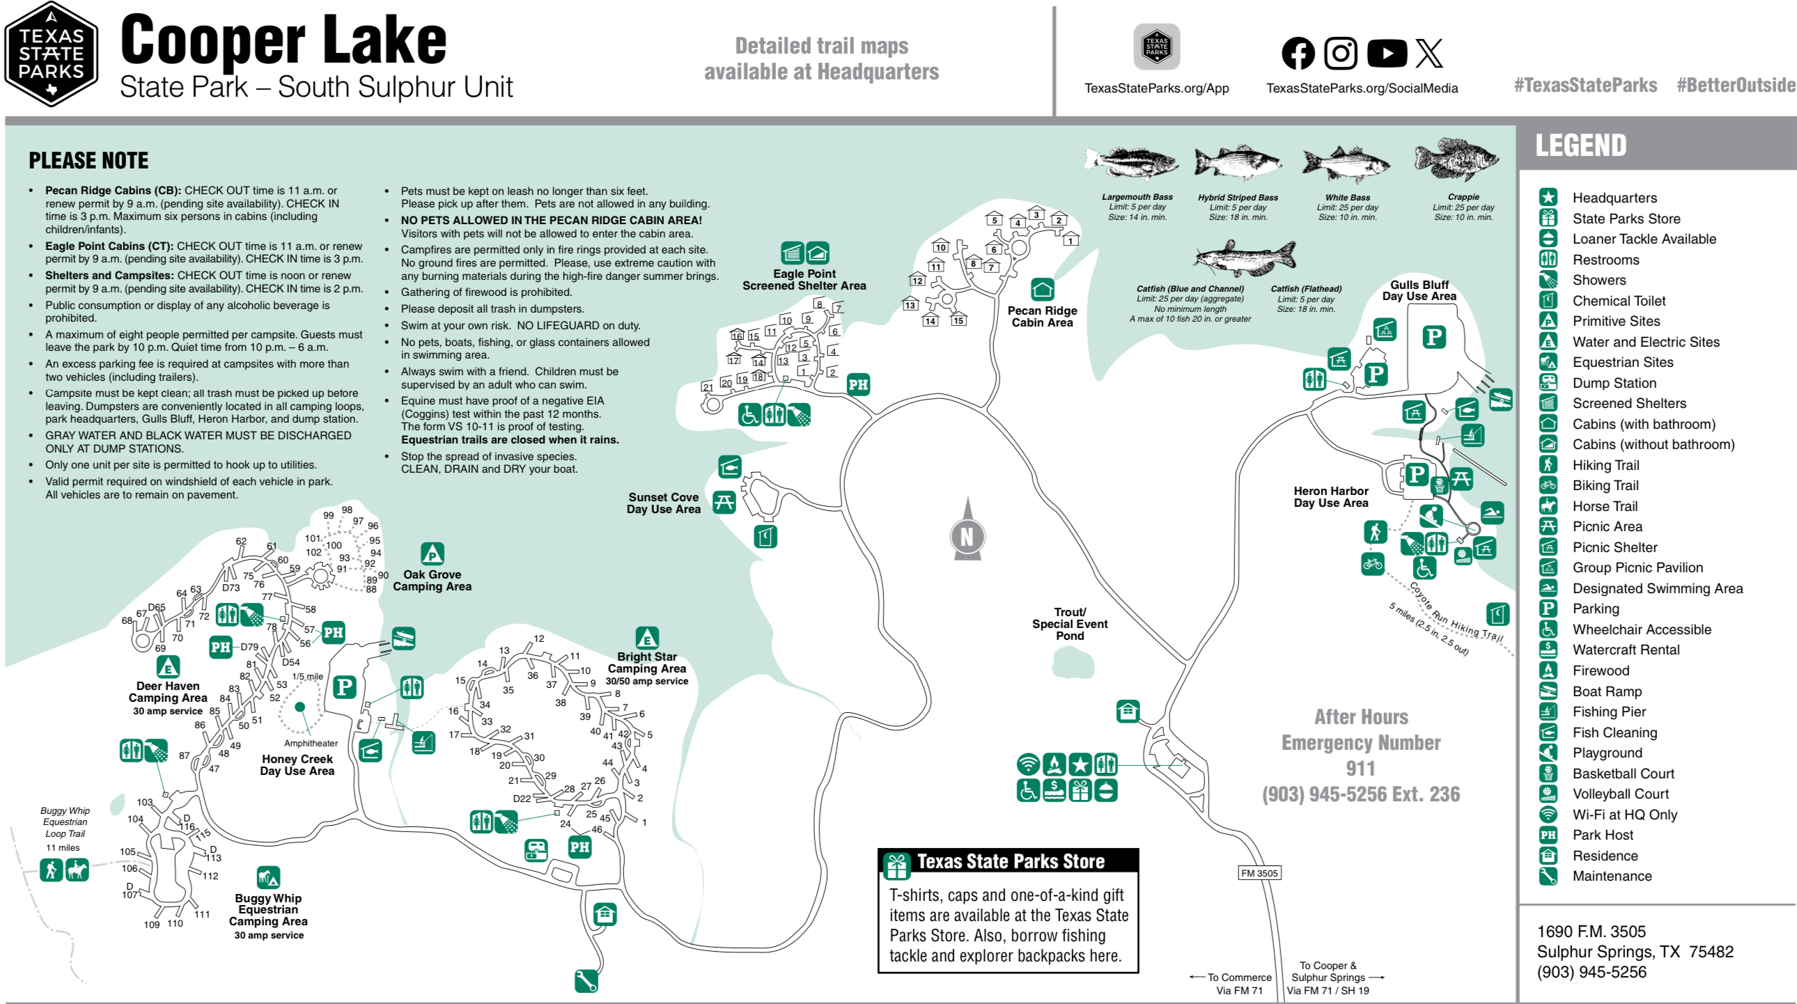
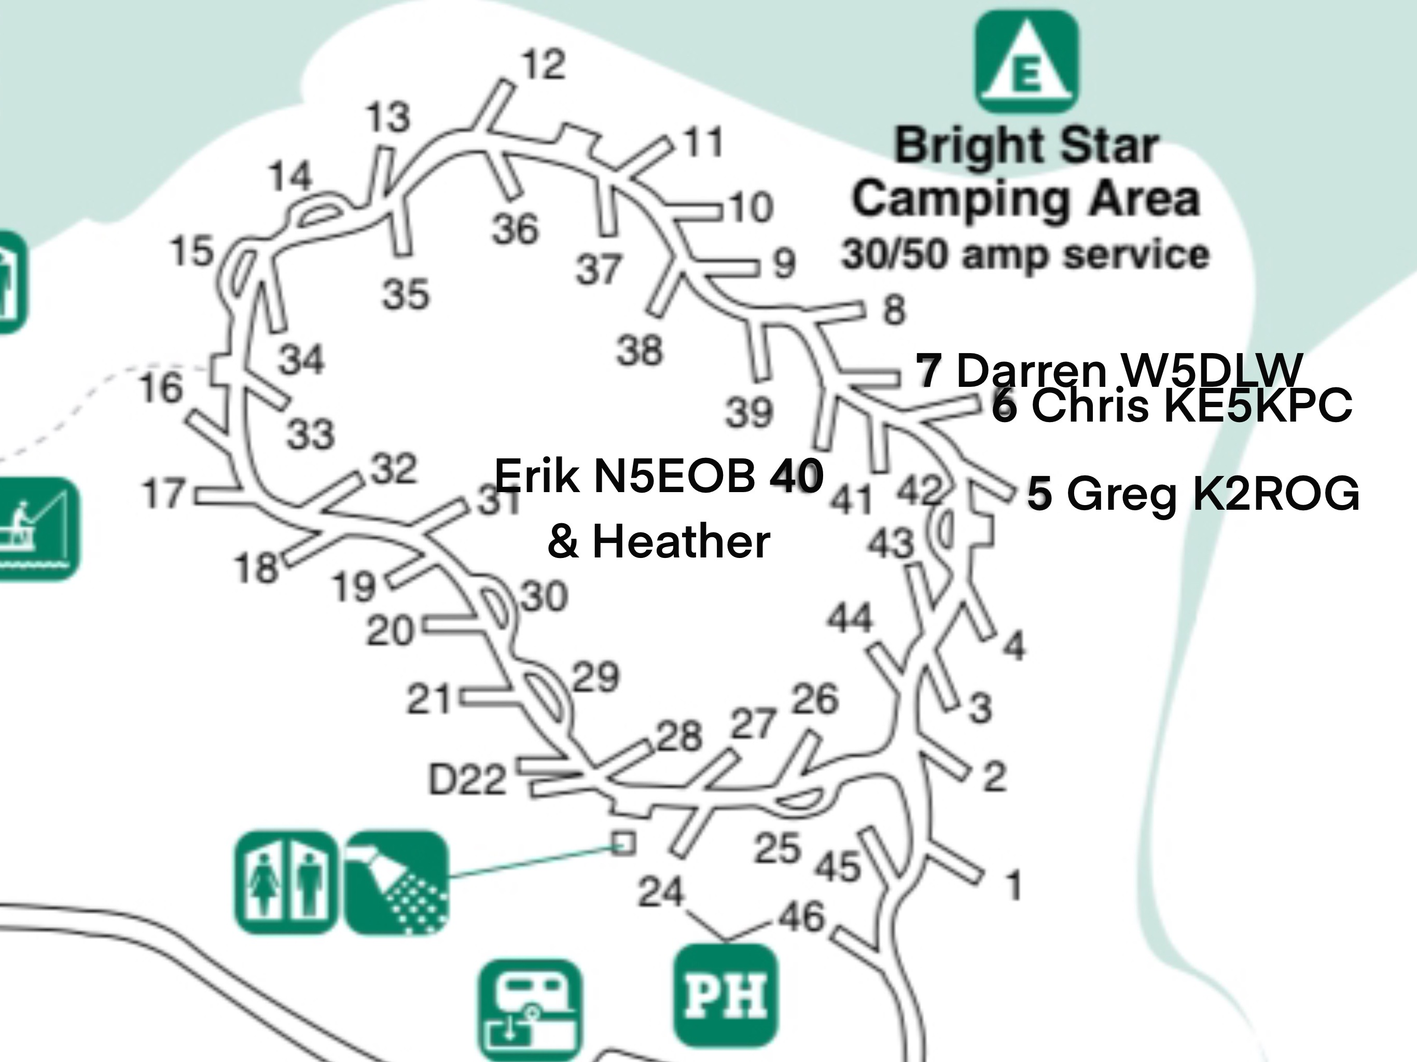
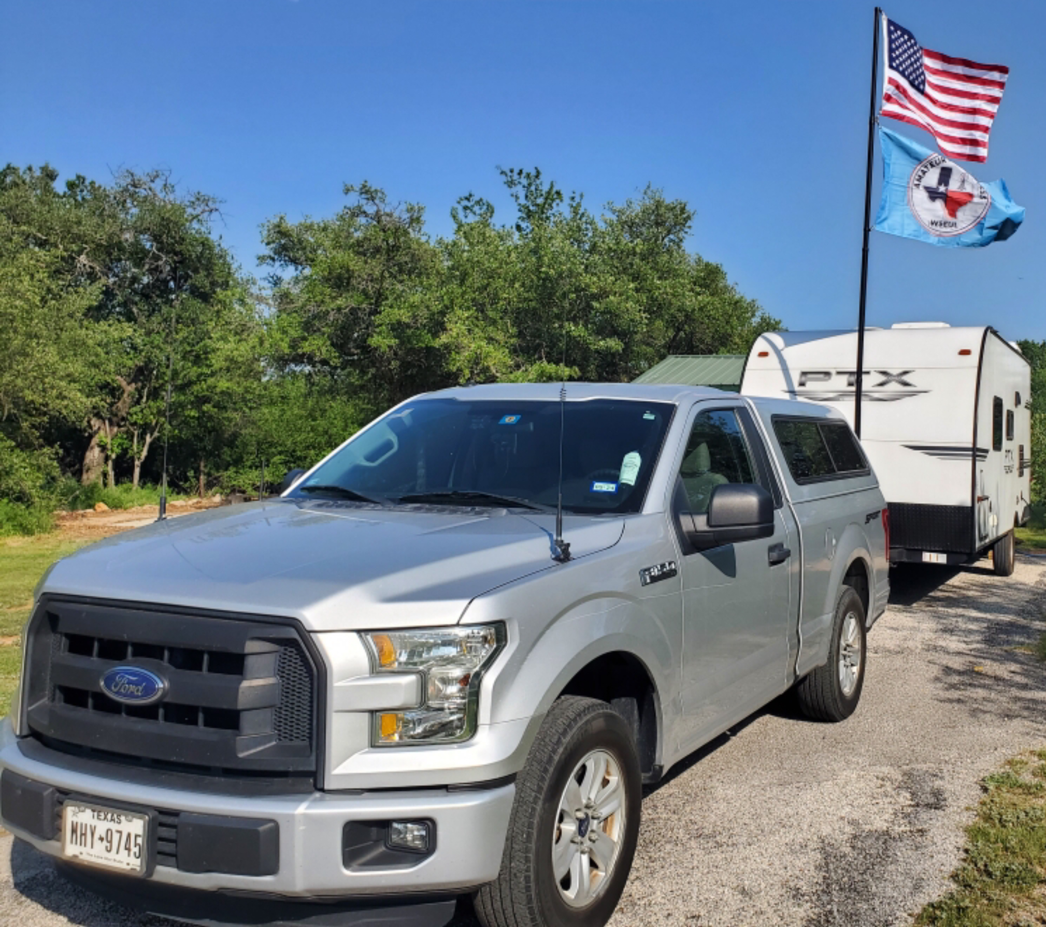
Cooper Lake State Park
South Sulphur Unit 10/12-13/2024
Parks On The Air

Slide 16
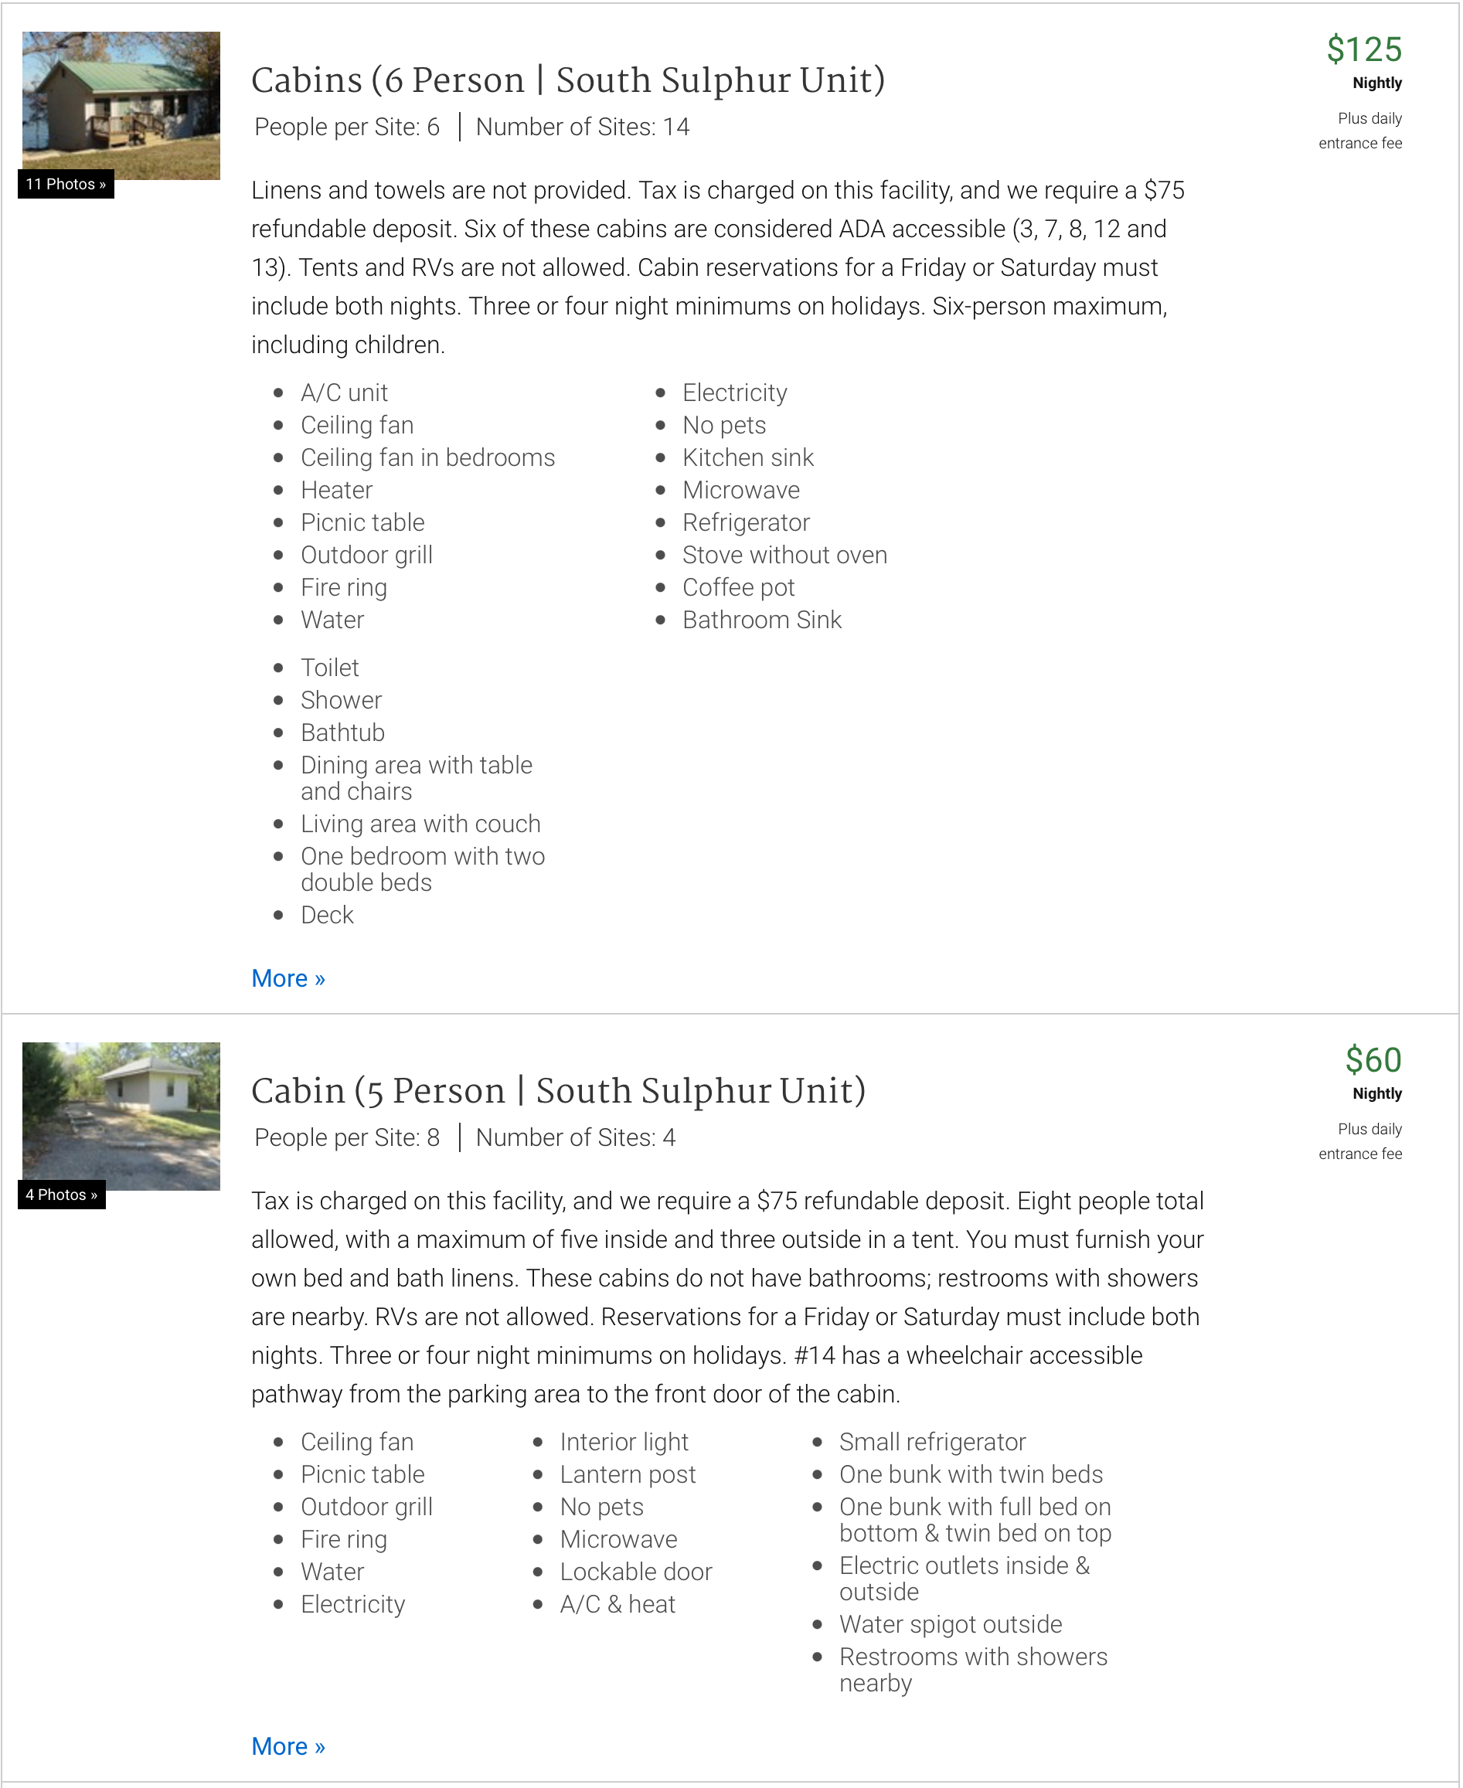
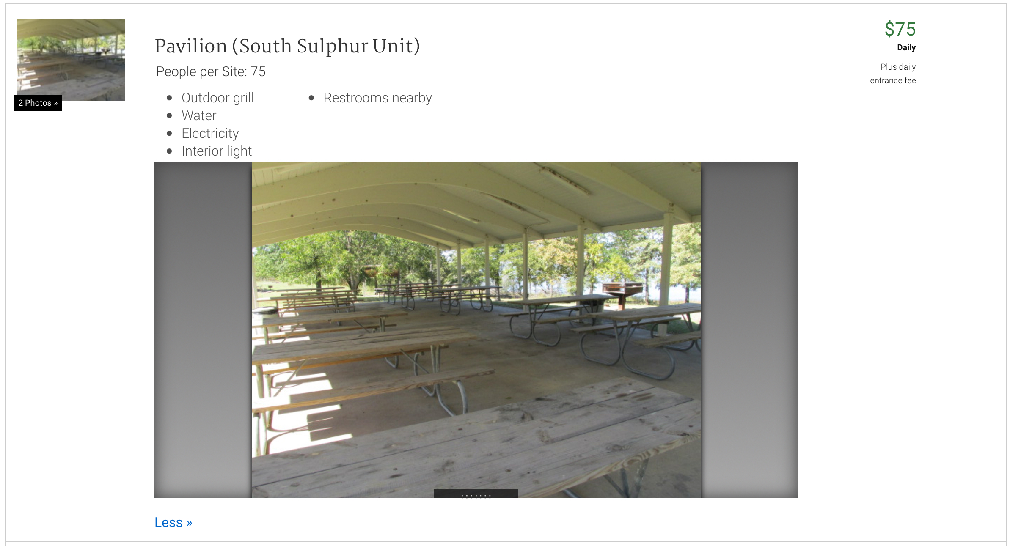
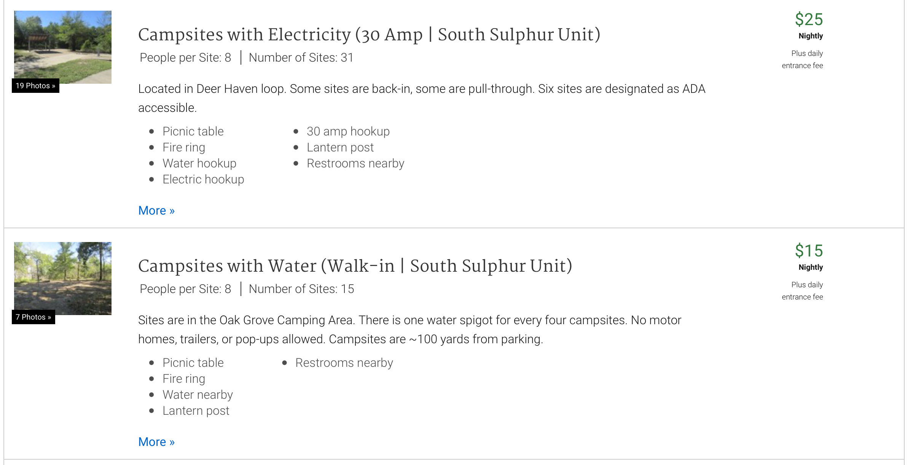
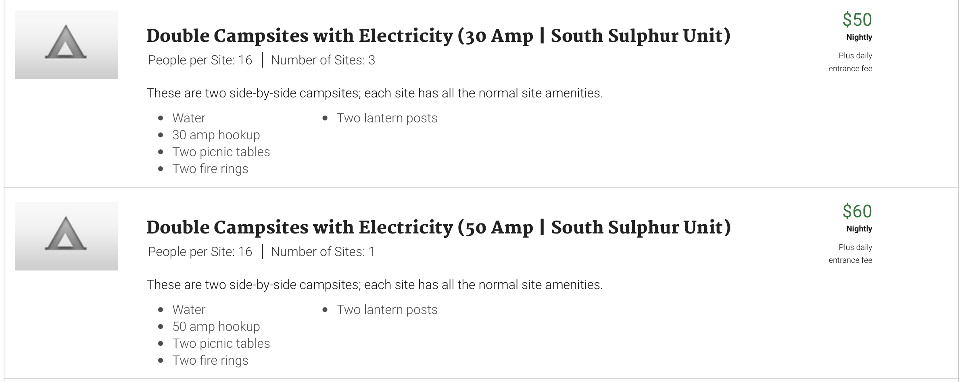
Cooper Lake State Park
South Sulphur Unit 10/12-13/2024
Parks On The Air

Slide 17
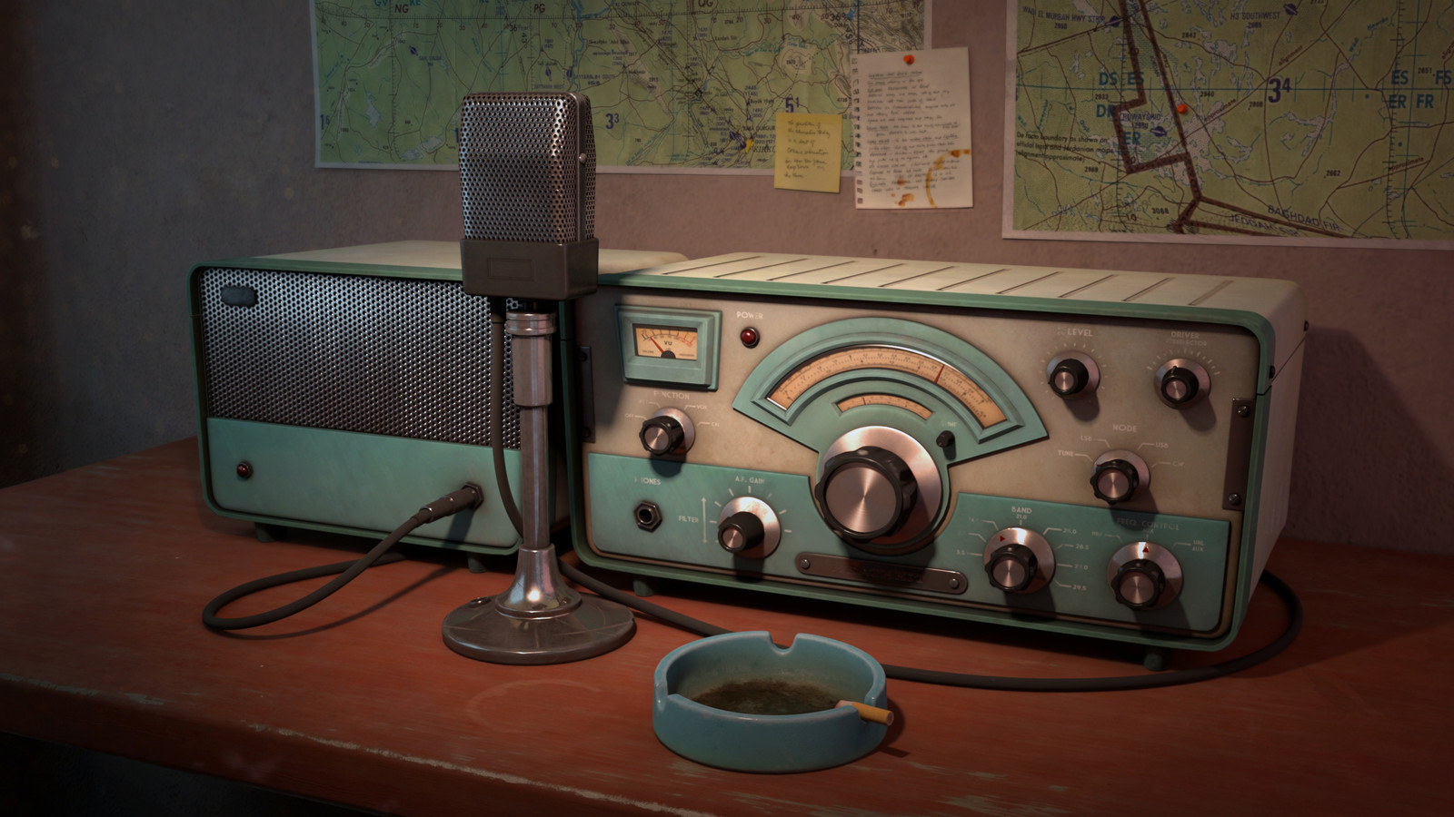
Erik
Greg
Chris
Members

