Slide 2
October 9, 2024

Slide 3
Introductions

Slide 4
Member Updates

Slide 5
Minutes

Slide 6
Treasurer’s Report

Slide 7
C.E.R.T Update

Slide 8
Local Happenings

Slide 9
Euless ARC Gatherings
ERBC – Every Friday, @ 0830
Texan Kitchen 415 N Main, Euless, TX 76039
H‑E‑B Joint Radio Club Breakfast, every 3rd Saturday, Egg Haven Cafe, 760 Airport Fwy, Suite 100, Hurst, RSVP by midnight Thursday
Club Social – Monday, October 21, 1800 – 1900 Potbelly Subs 2721 SH 121Frontage Rd Euless, TX 76039
Fox Hunt - Saturday, October 26, 0900

Slide 10
Previous Month Hours

Slide 11
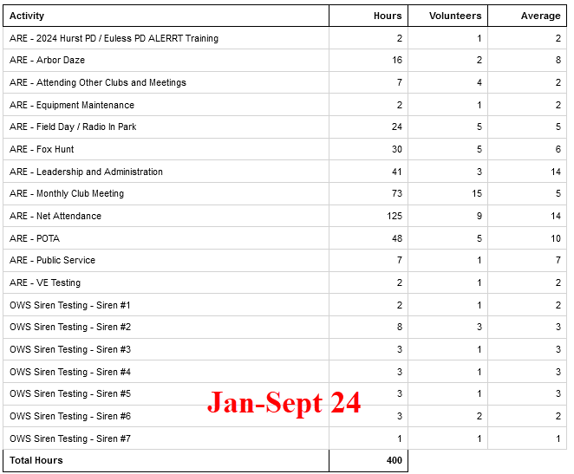
Year To Date Hours

Slide 12
Please log your hours.

Slide 13
Planning

Slide 14
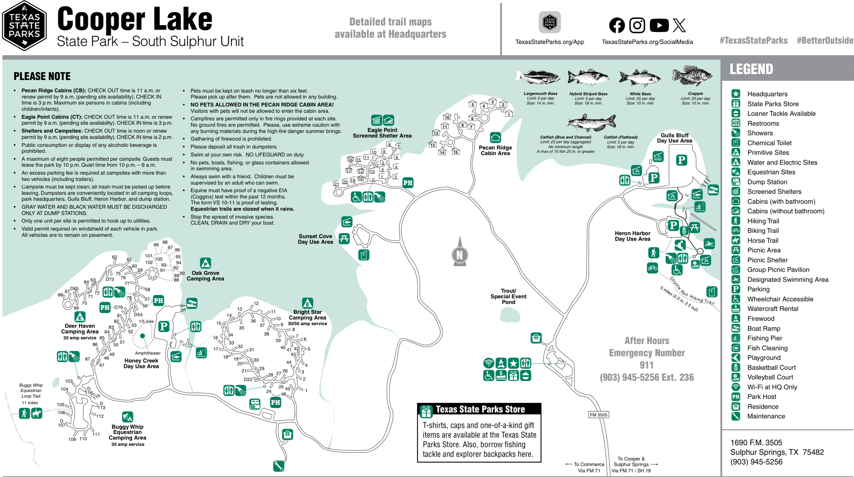
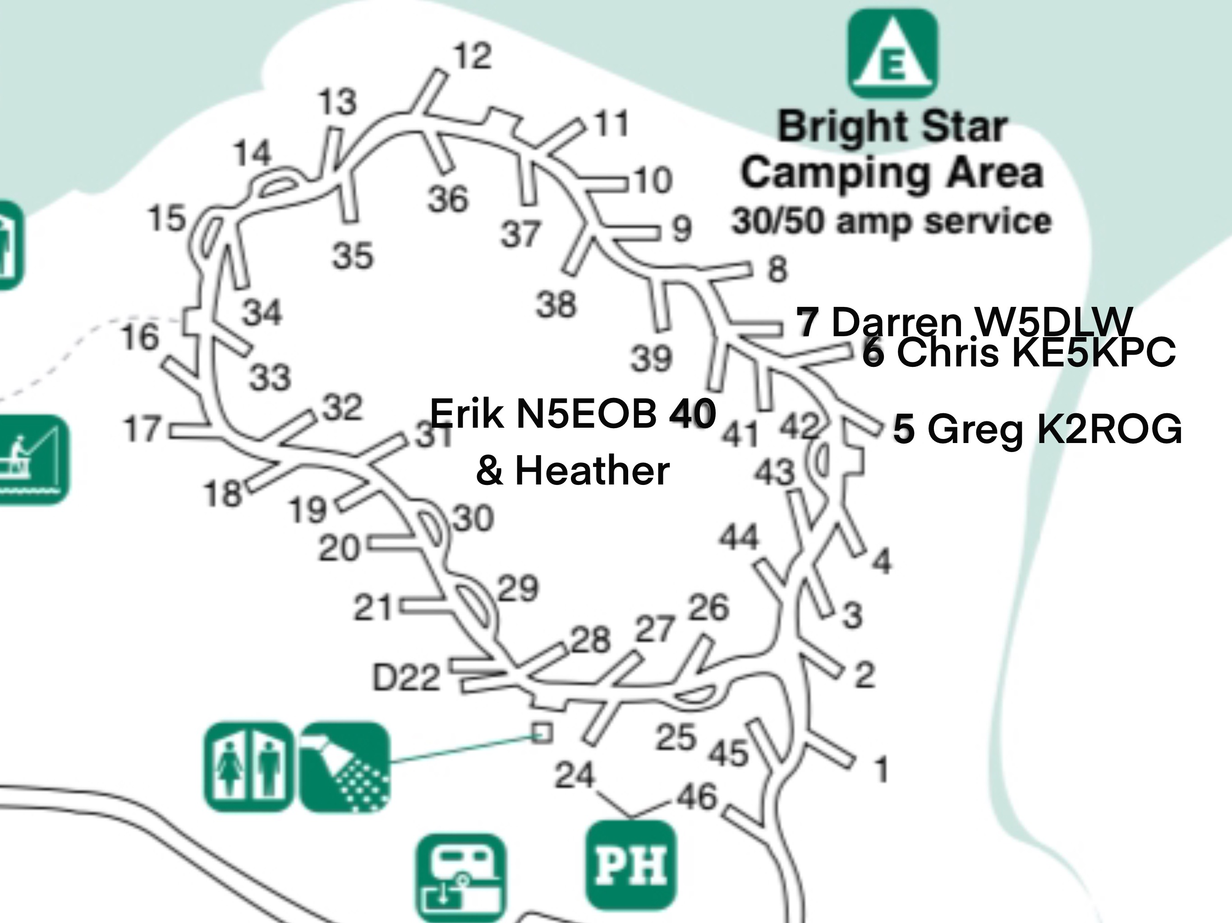
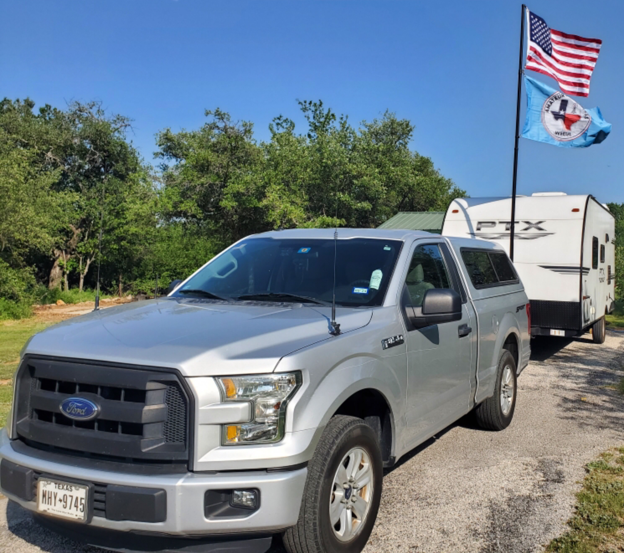
Cooper Lake State Park
South Sulphur Unit 10/12-13/2024
Parks On The Air

Slide 15
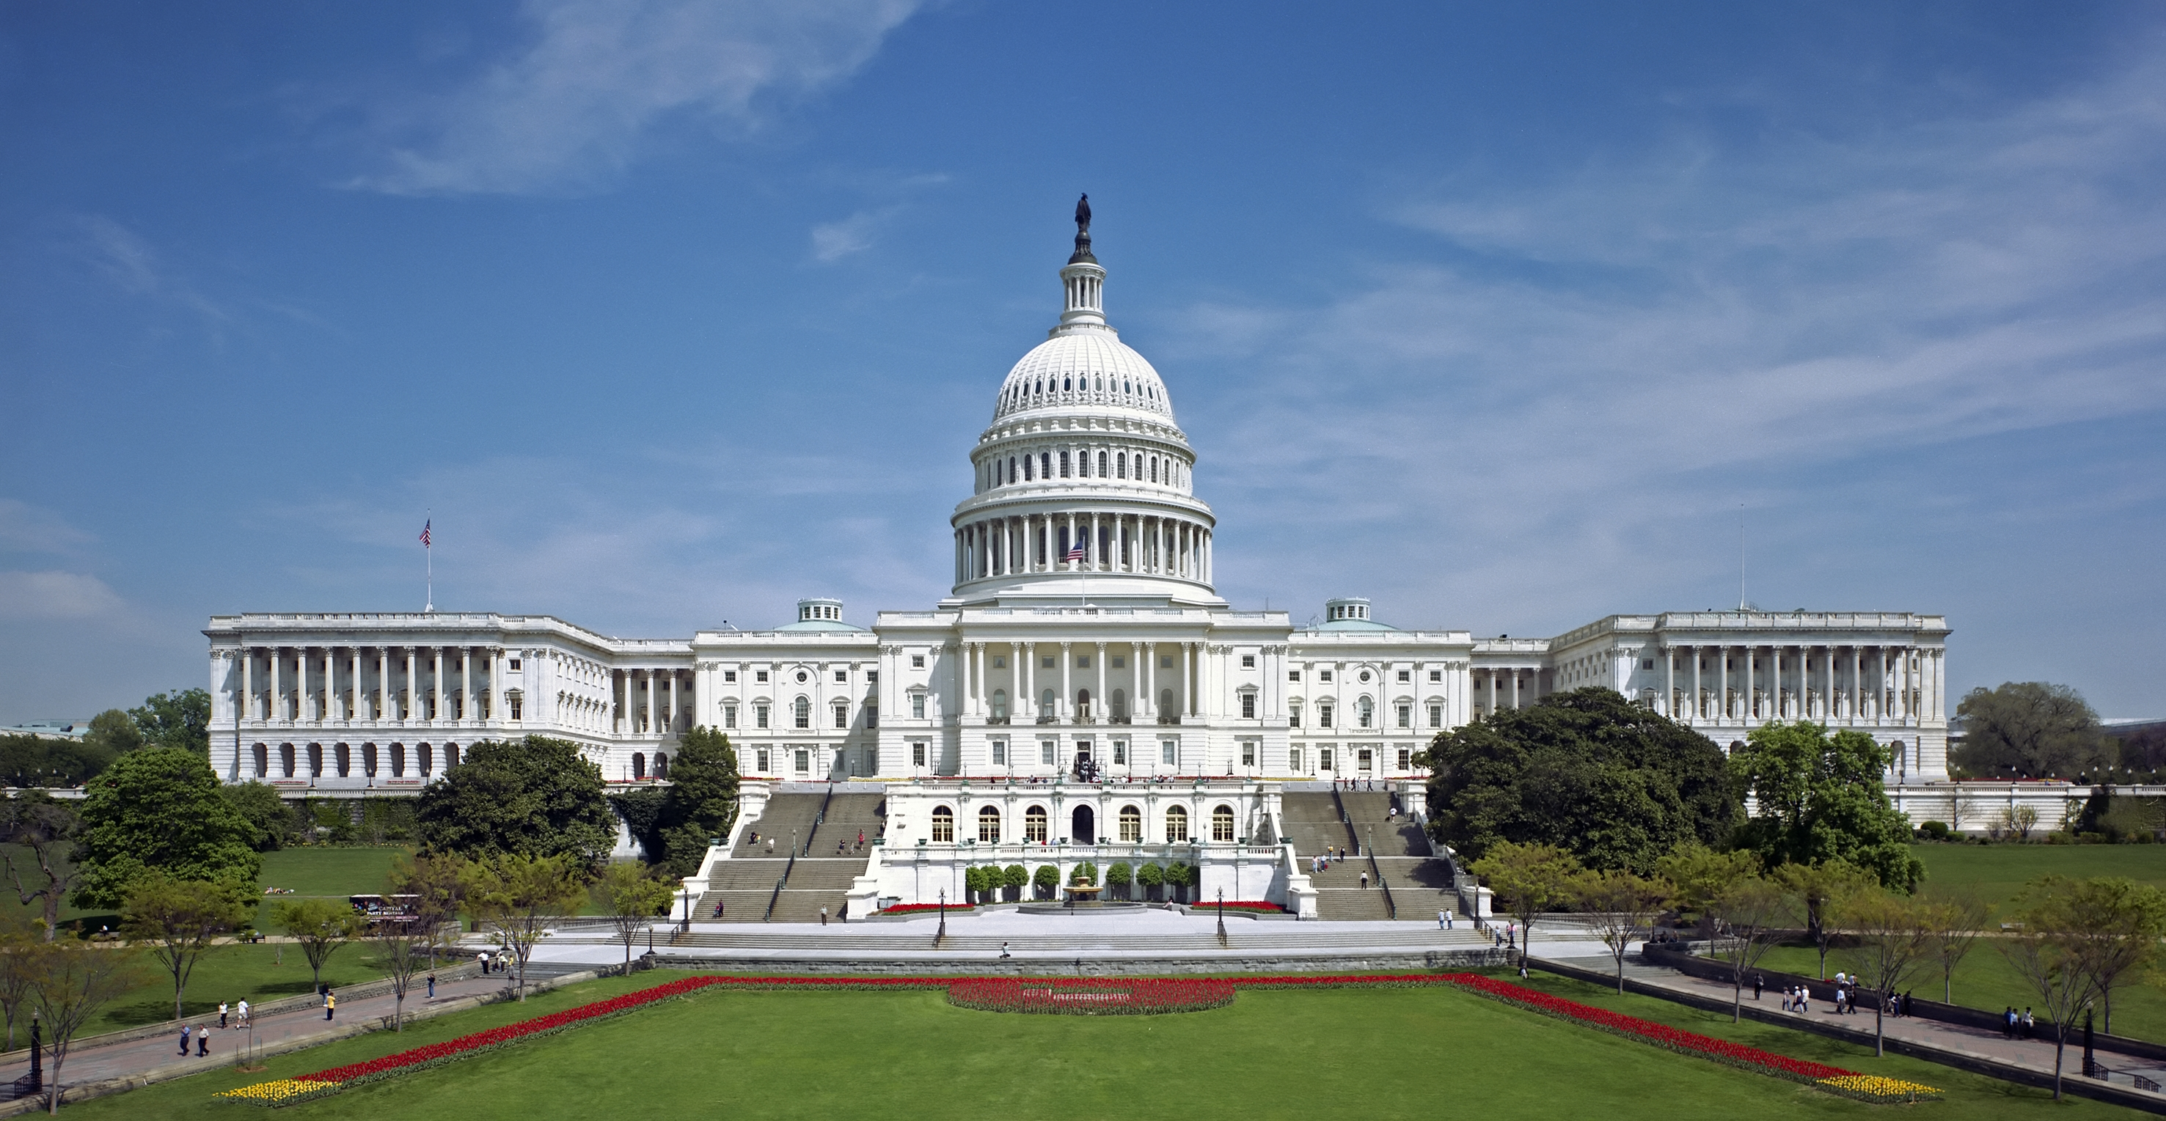
H.R. 4006 & S. 3690

Slide 16
Club Leadership Elections

Slide 17
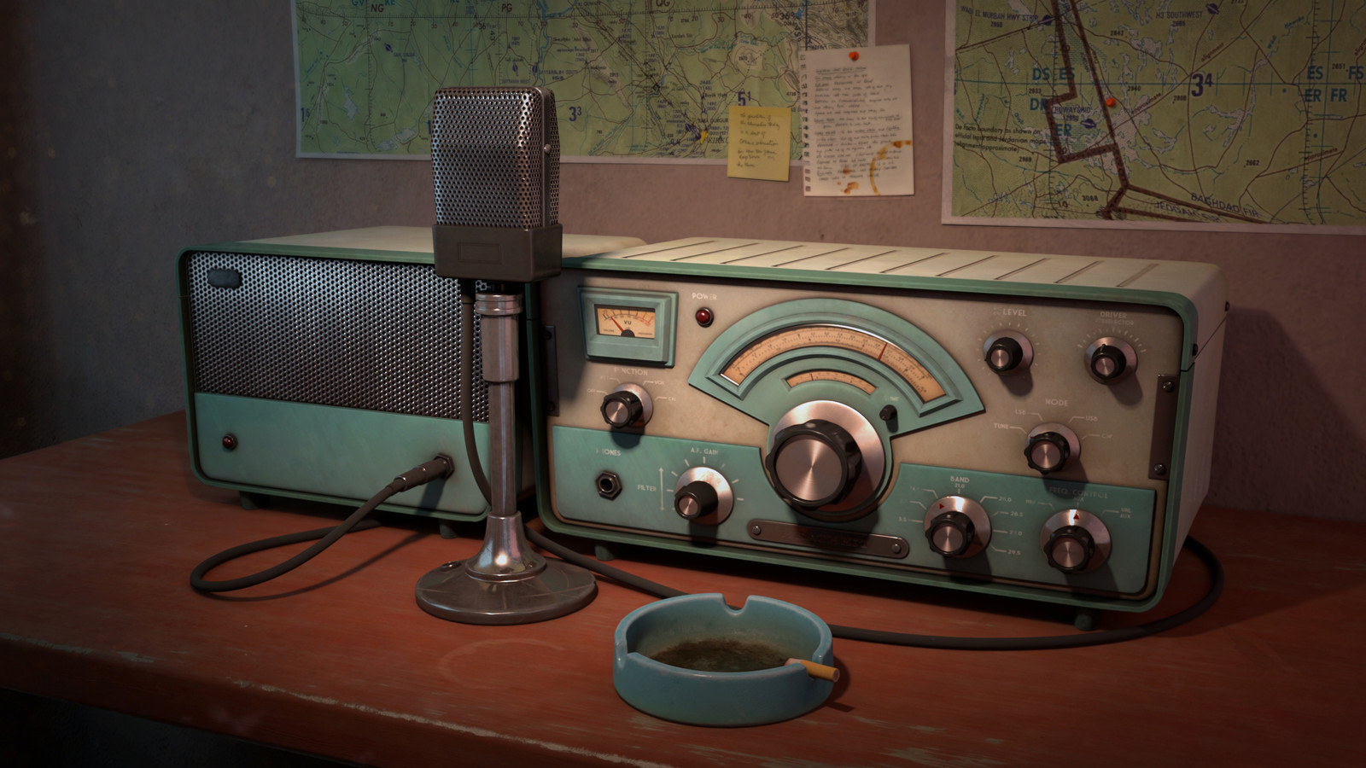
Erik
Greg
Chris
Members

